Slide 1

Text Notifications
Initial text notifications should be for a small batch of handpicked parents.
We recommend up to 10 families initially.

Slide 2
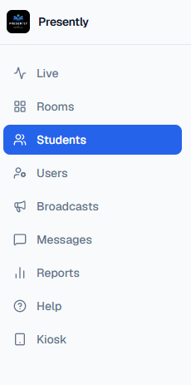
Step 1- Go to the Students Menu
1

Slide 3
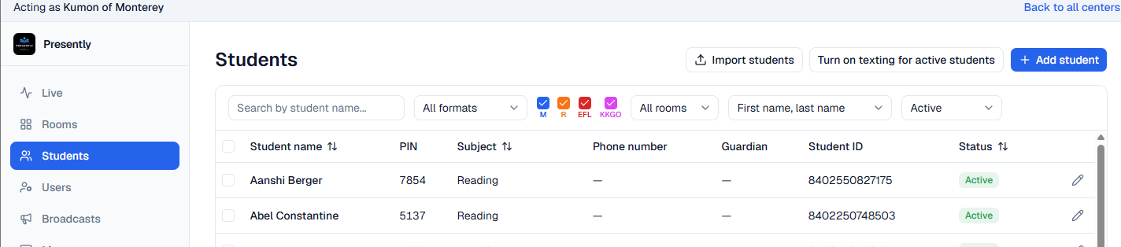

Step 2 – Select the desired student(s)
2

Slide 4
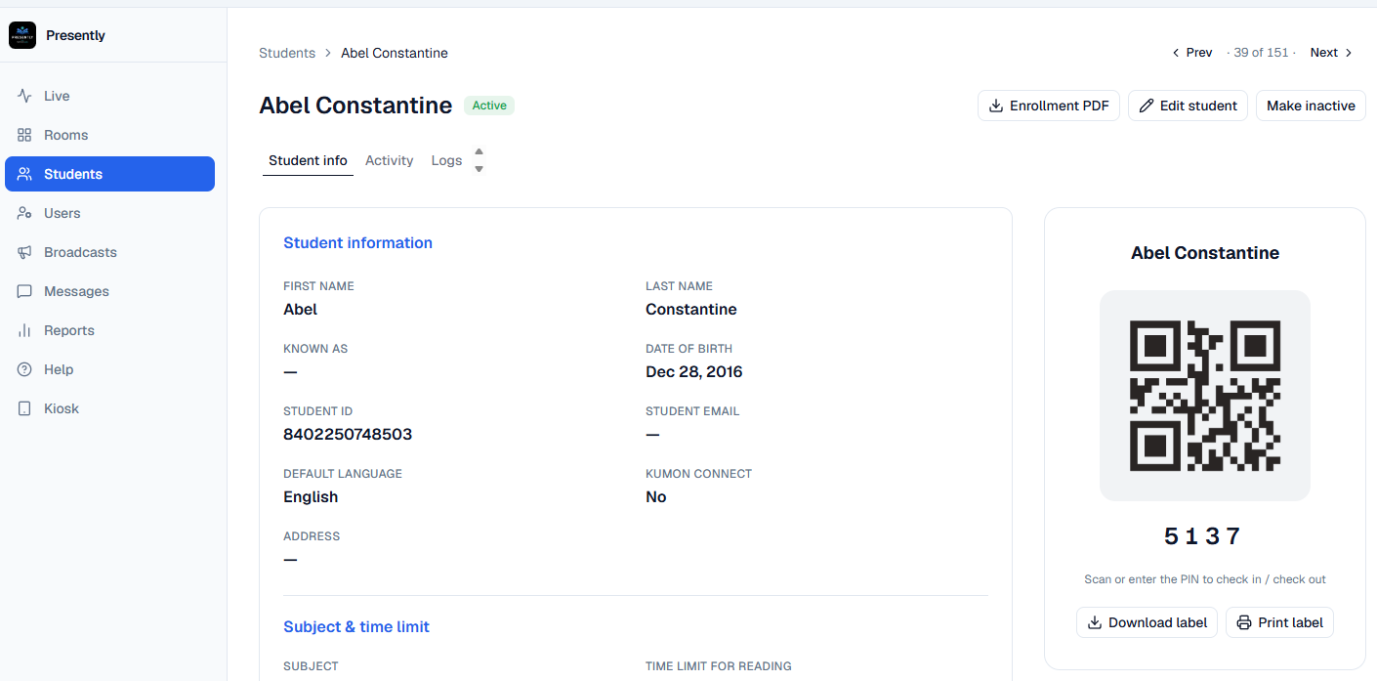
Step 3- ‘Click’ Edit Student
3

Slide 5
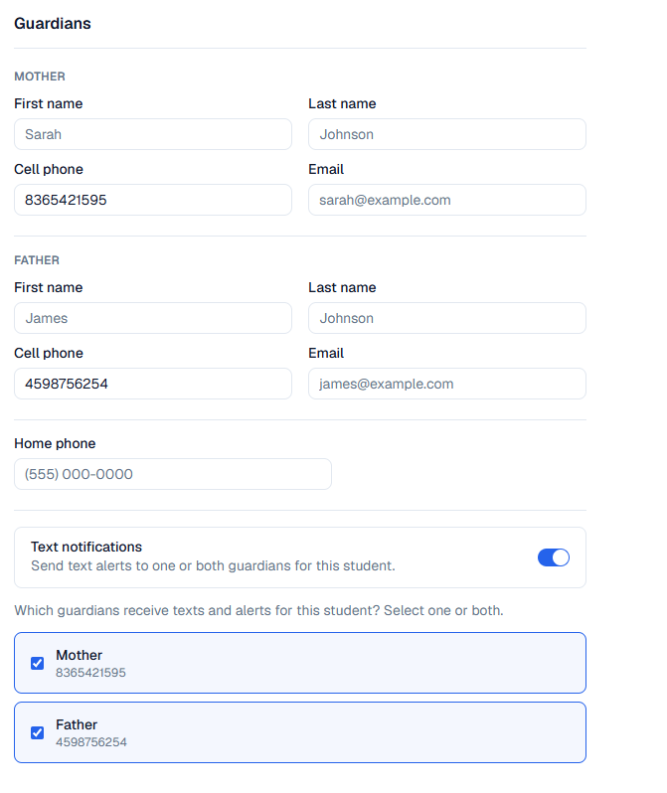
Step 4- Turn on the Text Notifications switch
4

Slide 6
Step 5- Select the Guardian(s) to notify
5

Slide 7
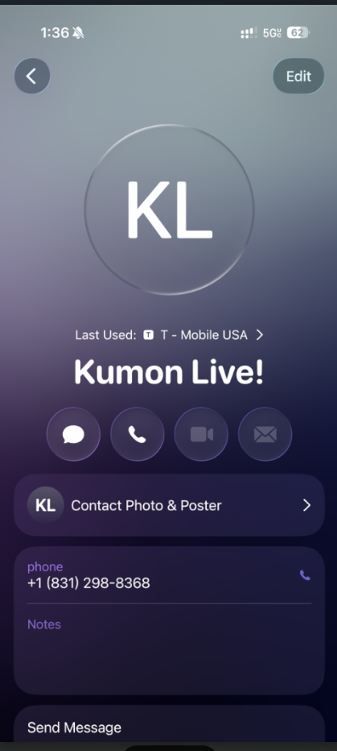
Step 6- Save Contact
Ask the parents to save the notification number which is
831-298-8368.
Some cellular providers may ask you to opt in first, so this bypasses that process.
You can text the number as a contact which then can be saved very quickly on a parent's phone. We labeled the contact as ‘Kumon Live!’
6

Slide 8
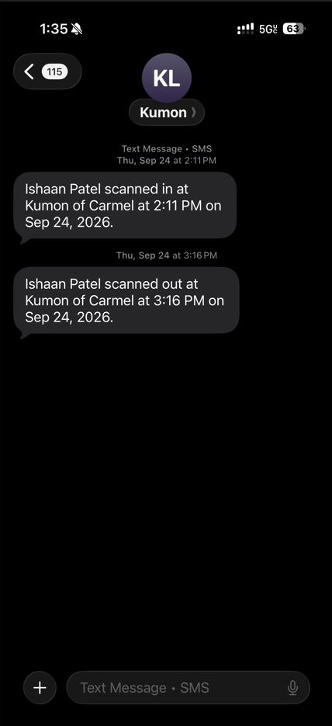
Step 7 – Check in with parents
After your first-class day with the texting option has been trialed; Check in with the small sample of parents and get their feedback.
They will have received one text at check in and another text at checkout. Check that they received both
The text sent to parents will show the name, center location and time.
You can also customize this message later.
7a- Check-in Text
7b- Check-out Text

Slide 9
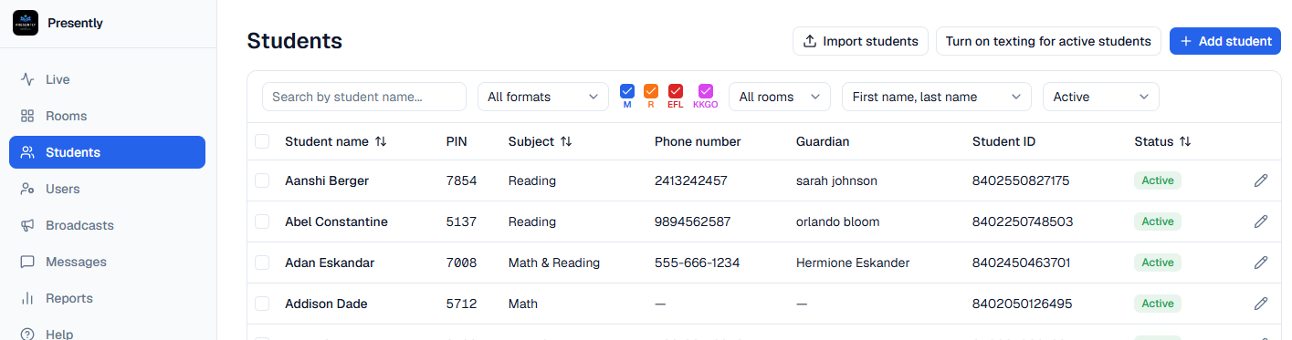
Step 8- Turn on notifications for all Parents
8
Complete this step once you are ready to deploy center-wide
Check that all students have guardian with a phone number in their profile . Here is an example of incomplete data. Here you will need to enter the data manually

Slide 10
Notes
Currently the notifications are one way. This means you can text the parent, but they can not text the center back. We will be integrating 2-way texting later.
The system will default to text the mother only. If you want to send notification to both guardians than you will need to turn it on manually in the student’s profile.

